Slide 1
Mastering Source Generators
Vladislav Antonyuk
.NET fwdays'24

Slide 2

Vladislav Antonyuk
Senior .NET Developer
Microsoft MVP
.NET MAUI Community Toolkit Core Maintainer
DataArt .NET Community Leader
Mentor

Slide 3
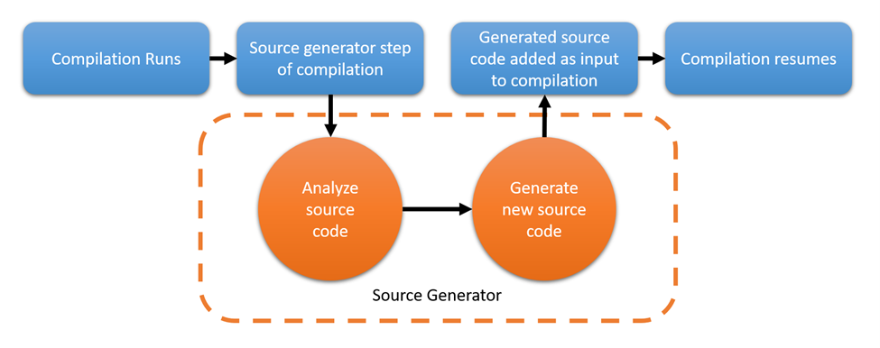
Source Generators
Source Generators is a Roslyn compiler feature introduced in .NET 5.
Source generators perform code generation at compile time, providing the ability to add source code to your project automatically.

Slide 4
Common scenarios
Runtime reflection
Juggling MSBuild tasks
Intermediate Language (IL) weaving

Slide 5
Where can I use them?
Dependency Injection (IoC Container)
Mappers
Enums
https://github.com/amis92/csharp-source-generators

Slide 6
Demo

Slide 7
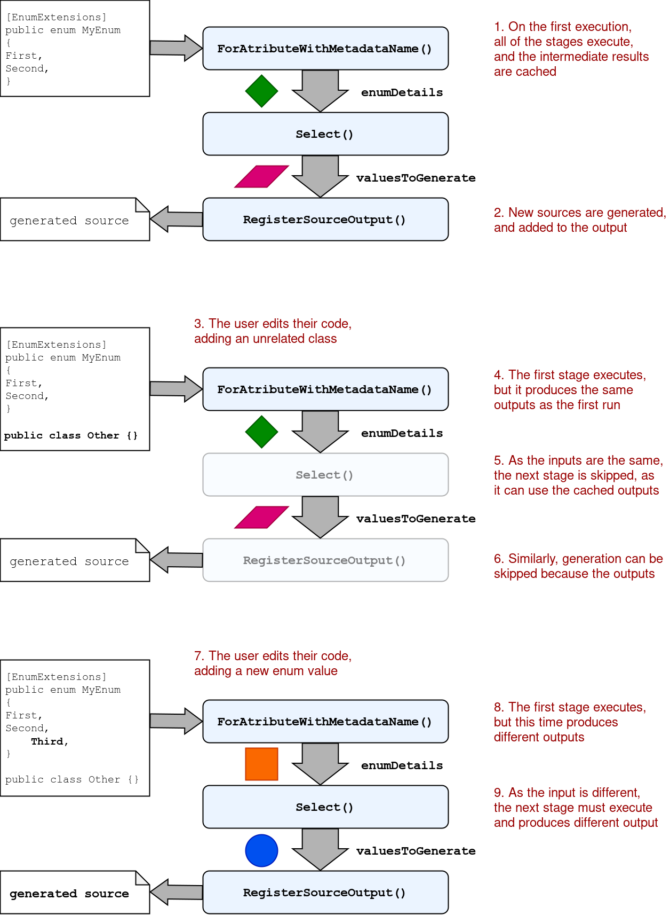
Cacheability is the most important factor

Slide 8
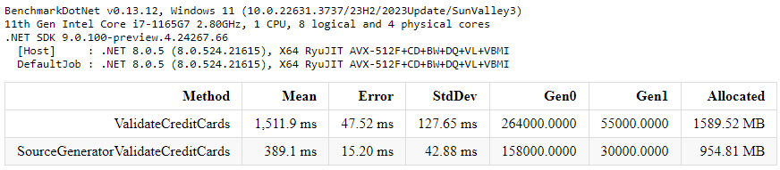
Benchmark results

Slide 9
References
https://learn.microsoft.com/en-us/dotnet/csharp/roslyn-sdk/source-generators-overview
https://andrewlock.net/series/creating-a-source-generator/

